Slide 1
DSC530-T301 Final Project
Anthony LaRosa
08/04/20
Professor Metzger

Slide 2
Statistical Question/Hypothesis
Statistical Question:
Does sleeping longer than 8 hours make you more tired?
Hypothesis:
Sleeping more than 8 hours results in greater next day tiredness

Slide 3
Outline of Minimum5 variables and Description of Variables
Enough(object) = Do you think that you get enough sleep?
Hours(float) = On average, how many hours of sleep do you get on a weeknight?
PhoneReach(object) = Do you sleep with your phone within arms reach?
PhoneTime(object) = Do you use your phone within 30 minutes of falling asleep?
Tired(Int) = On a scale from 1 to 5, how tired are you throughout the day? (1 being not tired, 5 being very tired)
Breakfast(object) = Do you typically eat breakfast?

Slide 4
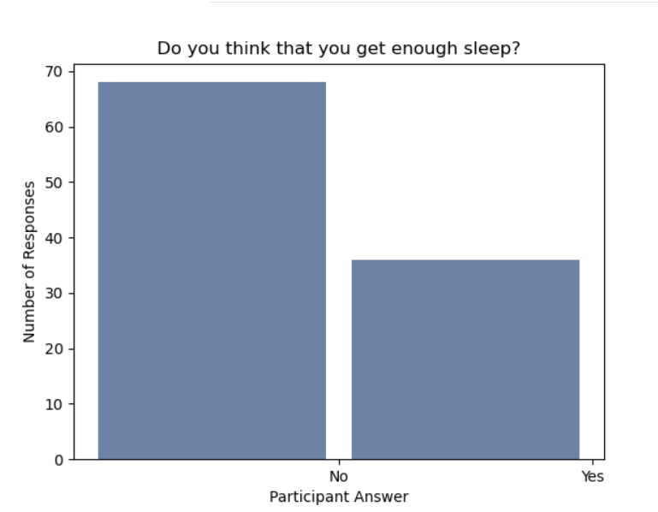
Include a histogram of each of the 5 variables

Slide 5
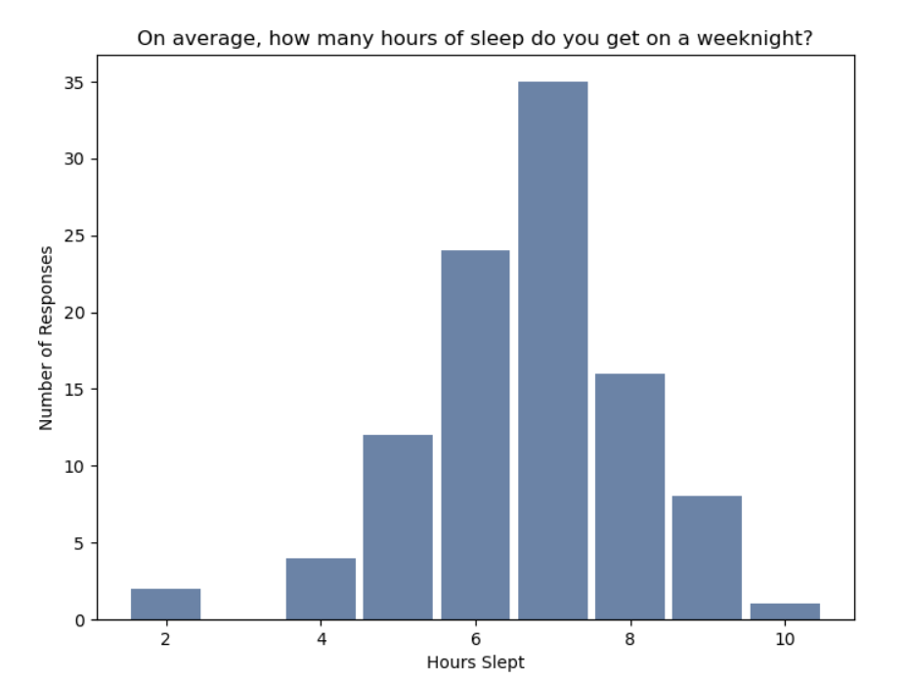
Include a histogram of each of the 5 variables

Slide 6
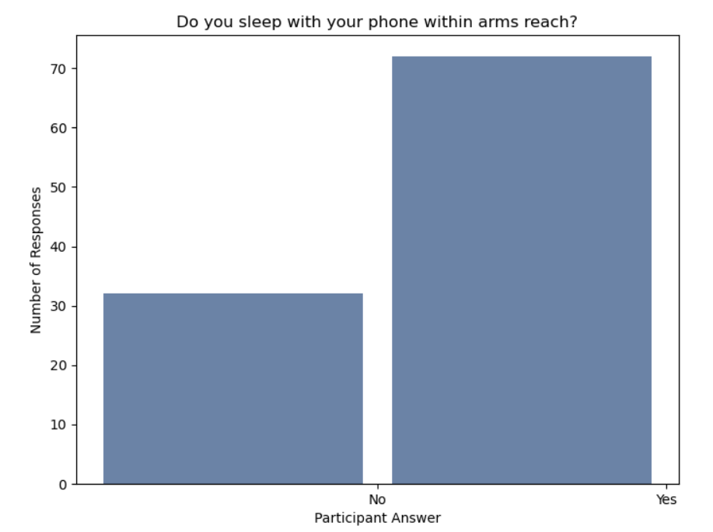
Include a histogram of each of the 5 variables

Slide 7
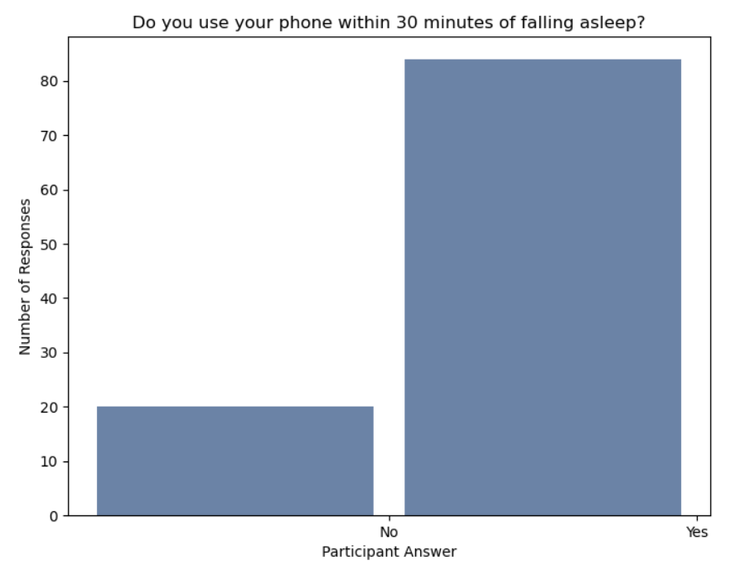
Include a histogram of each of the 5 variables

Slide 8
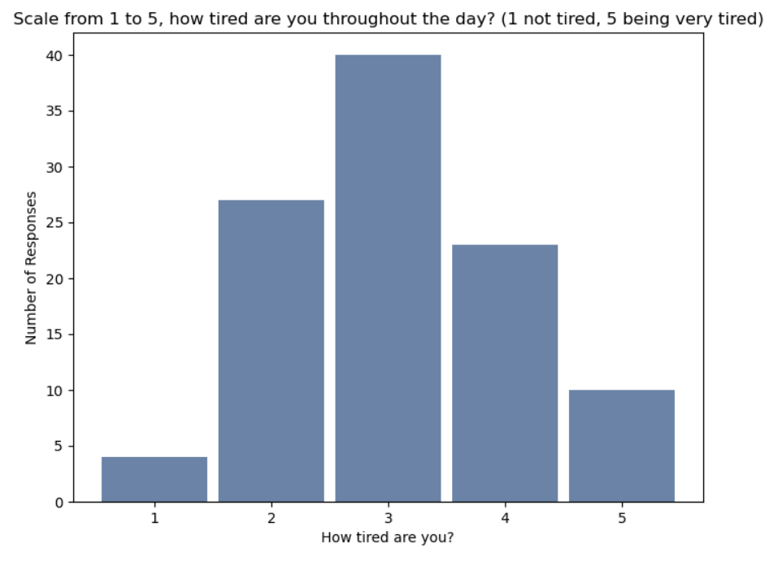
Include a histogram of each of the 5 variables

Slide 9
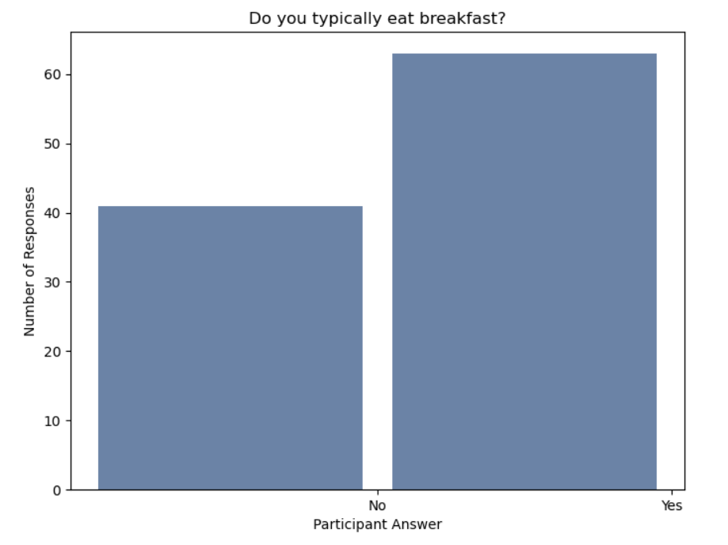
Include a histogram of each of the 5 variables

Slide 10
Include the other descriptive characteristics about the variables: Mean, Mode, Spread, and Tails
The two variable types that this can be performed on the Hours variable and the Tired variable
Mean of Hours Slept = 6.375
Median of Hours Slept = 6.5
Mode of Hours Slept = 7
The Spread of Hours Slept = 2.66
Mean of Tired Scale = 3.0
Median of Tired Scale = 3.0
Mode of Tired Scale = 3
The Spread of Tired Scale is 1.58

Slide 11
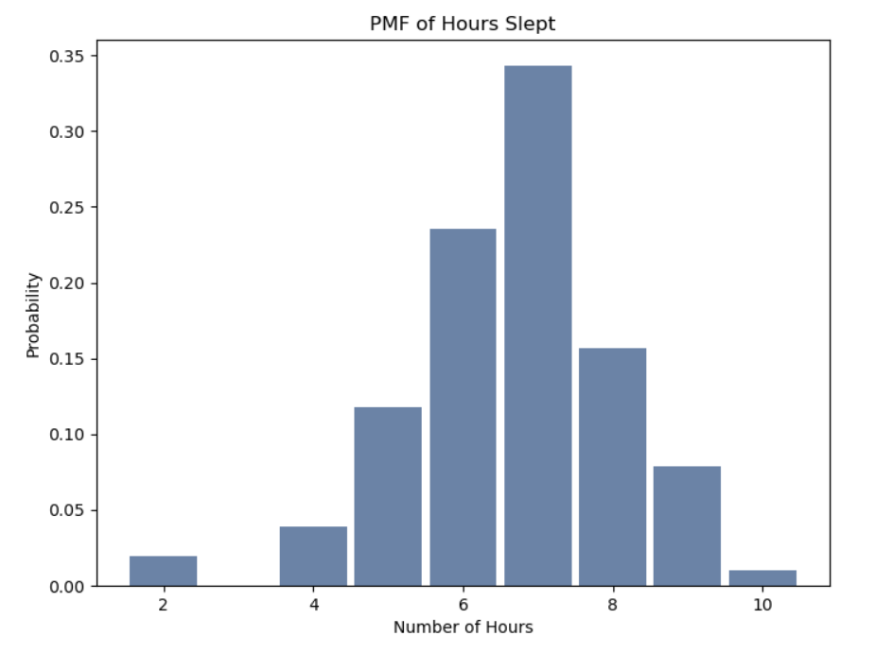
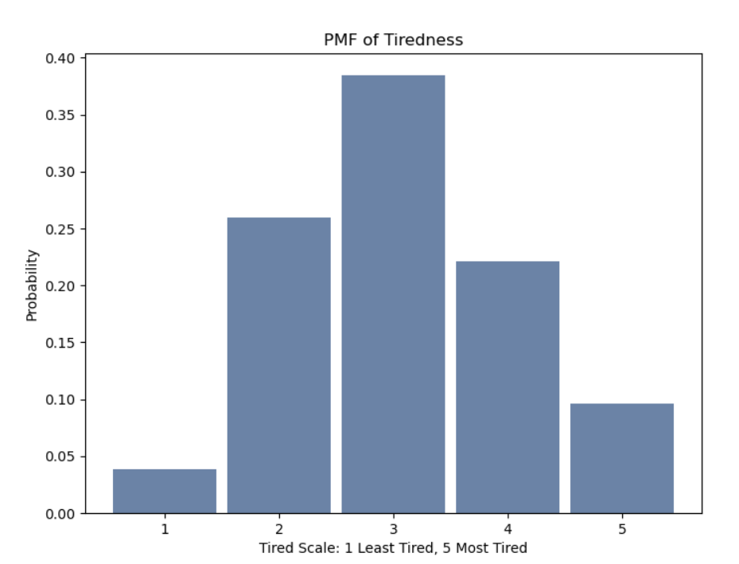
Analyze Data with PMF

Slide 12
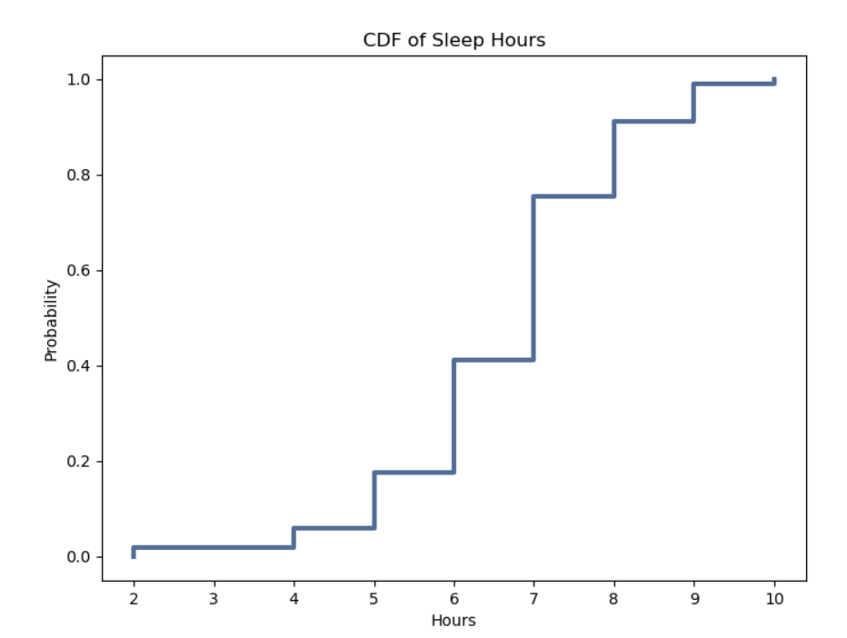
Create 1 CDF with One of Your Variables

Slide 13
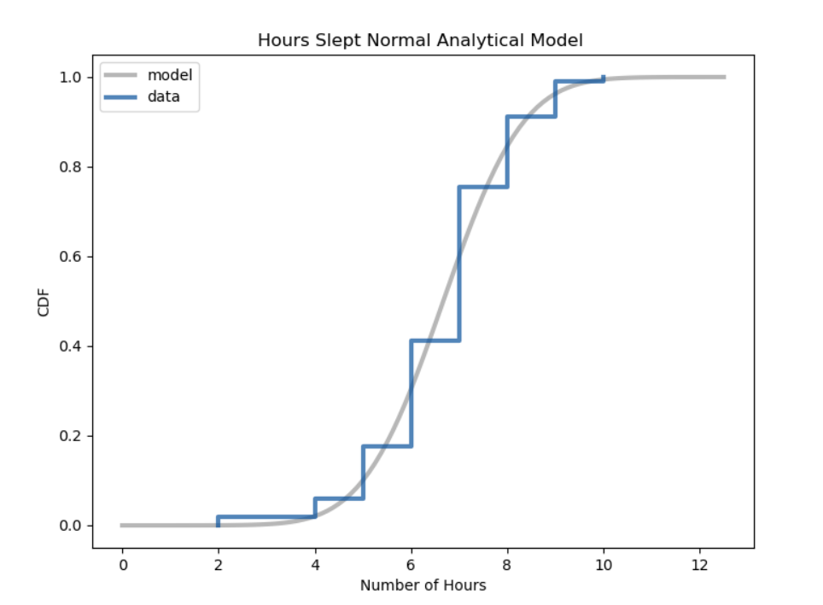
Plot 1 Analytical Distribution and Provide your Analysis
Mean 6.67
Var 1.70
Sigma 1.30

Slide 14
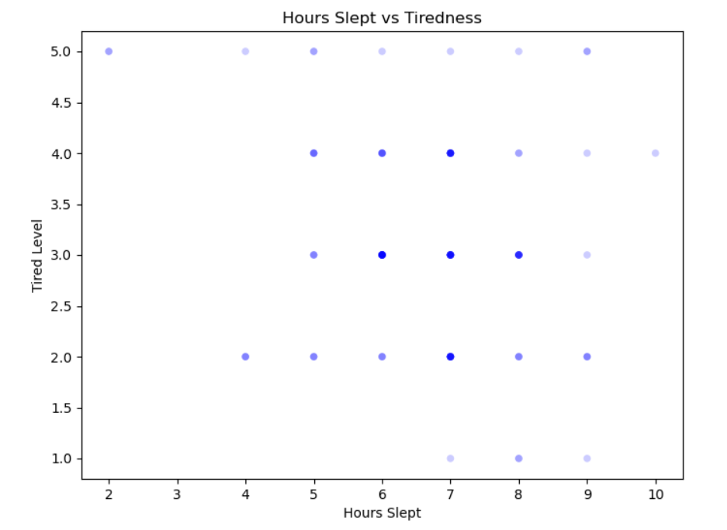
Create Two Scatter Plots Comparing Two Variables

Slide 15
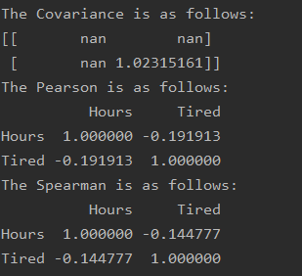
Covariance, Pearson’s correlation, and Non-Linear Relationships should also be considered during your analysis
I can see the causation from this calculations that there is an inverse relationship, which means, the more hours that you sleep the less tired you are.

Slide 16
Conduct a test on your Hypothesis
In my hypothesis testing below I found that from reviewing my p-value, actual p-value, and max statistical value, that I am supporting the null hypothesis and not my hypothesis. This is backed by my previous slide on the correlation tests.
0.053 – P-Value
0.19191266936641266 – Actual P-Value
0.3225507983555616 – Max Statistical

Slide 17
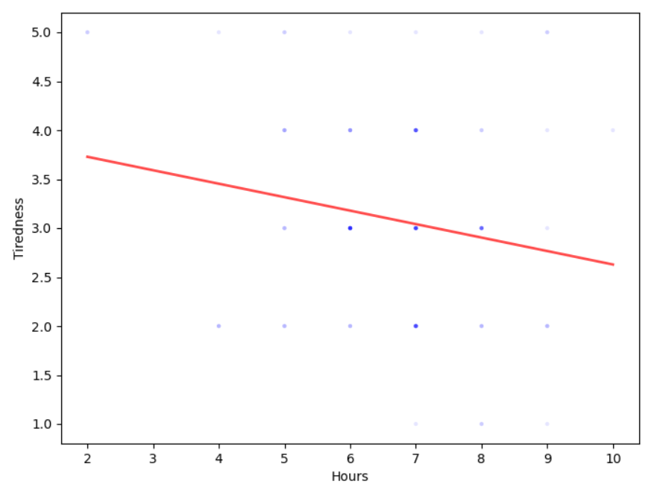
Final Step: Conduct a Regression Analysis
I was happy when I performed this regression analysis as the final step, because it tied together and provided further supporting evidence tying together all of the statistical analysis on the previous slides to this point.
The more sleep you get, the less tired you are from this dataset.

